Slide 1


A Data Management and Intelligent Automation Company

Slide 2


Agenda
Pendo – An all-in-one platform for digital experiences

Slide 3

What is Pendo.io?
Pendo is a platform that combines analytics, in-app guidance, user feedback, and community resources to help companies improve their products.
leveraging these tools, businesses can innovate more confidently and adapt quickly to changing user needs, ultimately delivering better product experiences to their customers or employees.

Slide 4


Slide 5
Why Pendo?
Pendo is simply about making our users experience inside your product better in 2 ways :
Understanding User Behavior :
- by tracking user actions and behaviors.
Guiding User Experience :
- through interactive in-app messaging and guidance.

Slide 6
Features of Pendo:
Product Usage Analytics
In-App Messaging
In-App Guides and Walkthroughs
User Feedback Surveys
Product Roadmaps
Customer Segmentation
Data Integration
Usage-Based Analytics
Product Metrics Dashboard
User Behavior Tracking
Product Surveys and Polls
Mobile App Support
Security and Compliance.

Slide 7
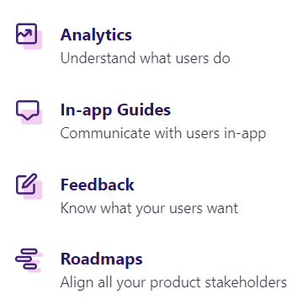
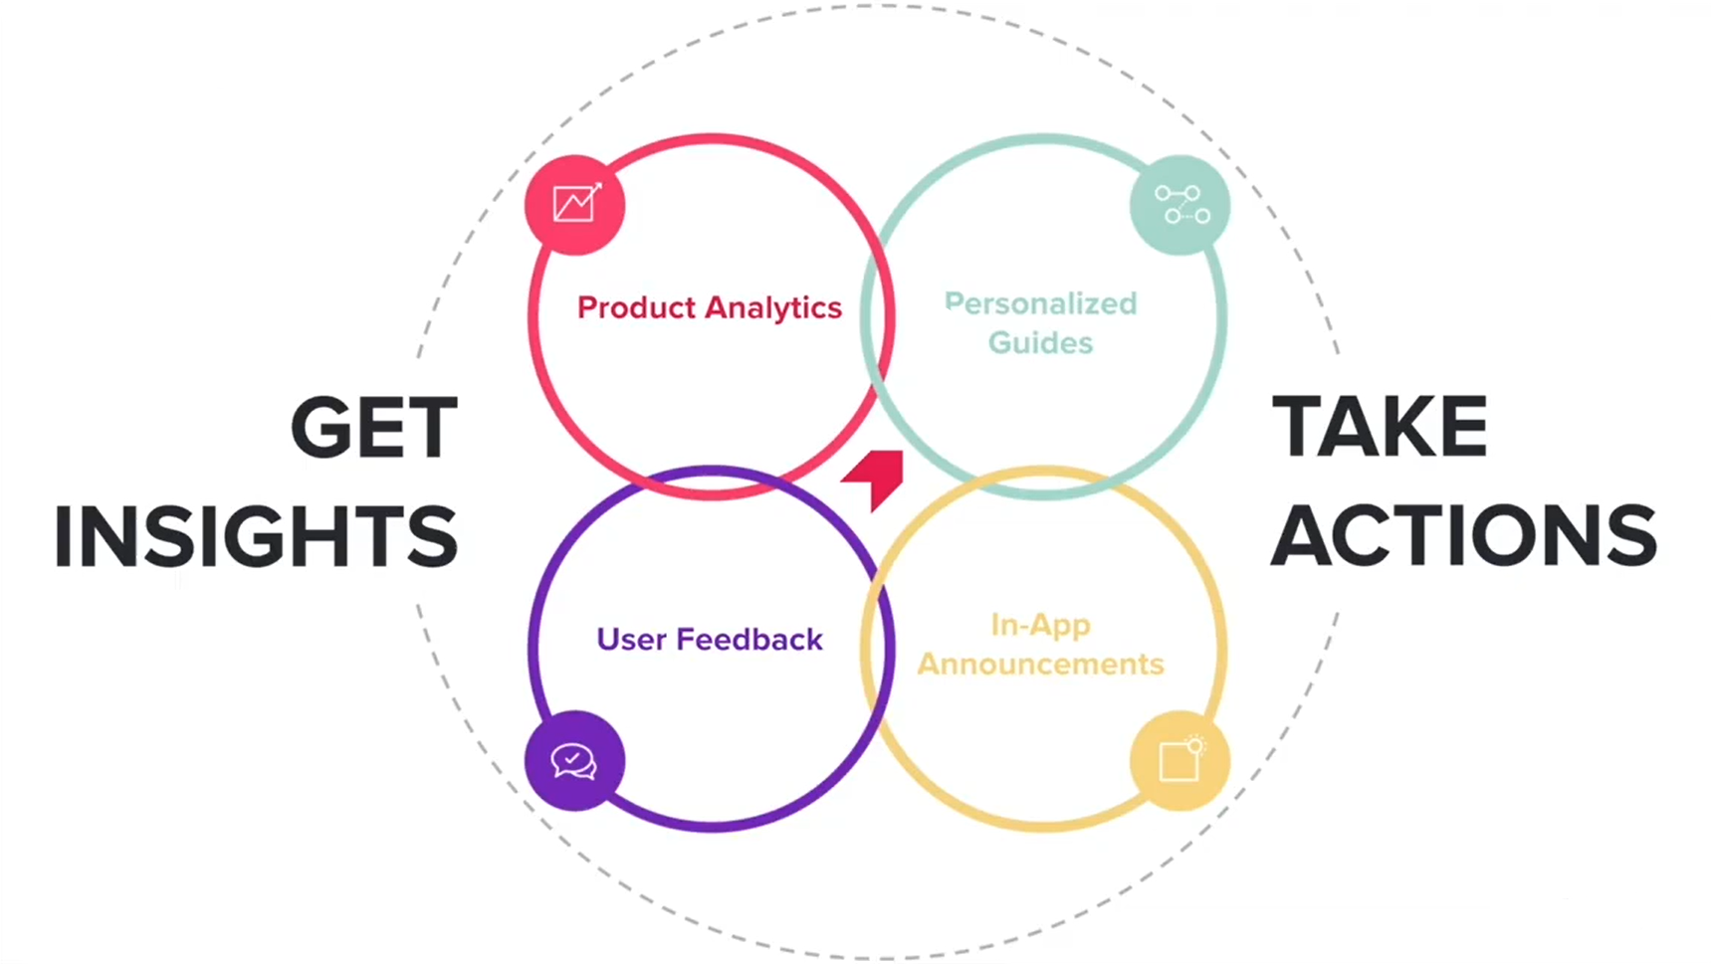
Pendo features in Dextrix:

Slide 8
Demonstration for Dextrix with Pendo:
Products
Pages
Features
Track events
Guides
NPS
Behavior
Paths
Funnels
Retention
People
Dashboard
Road map

Slide 9
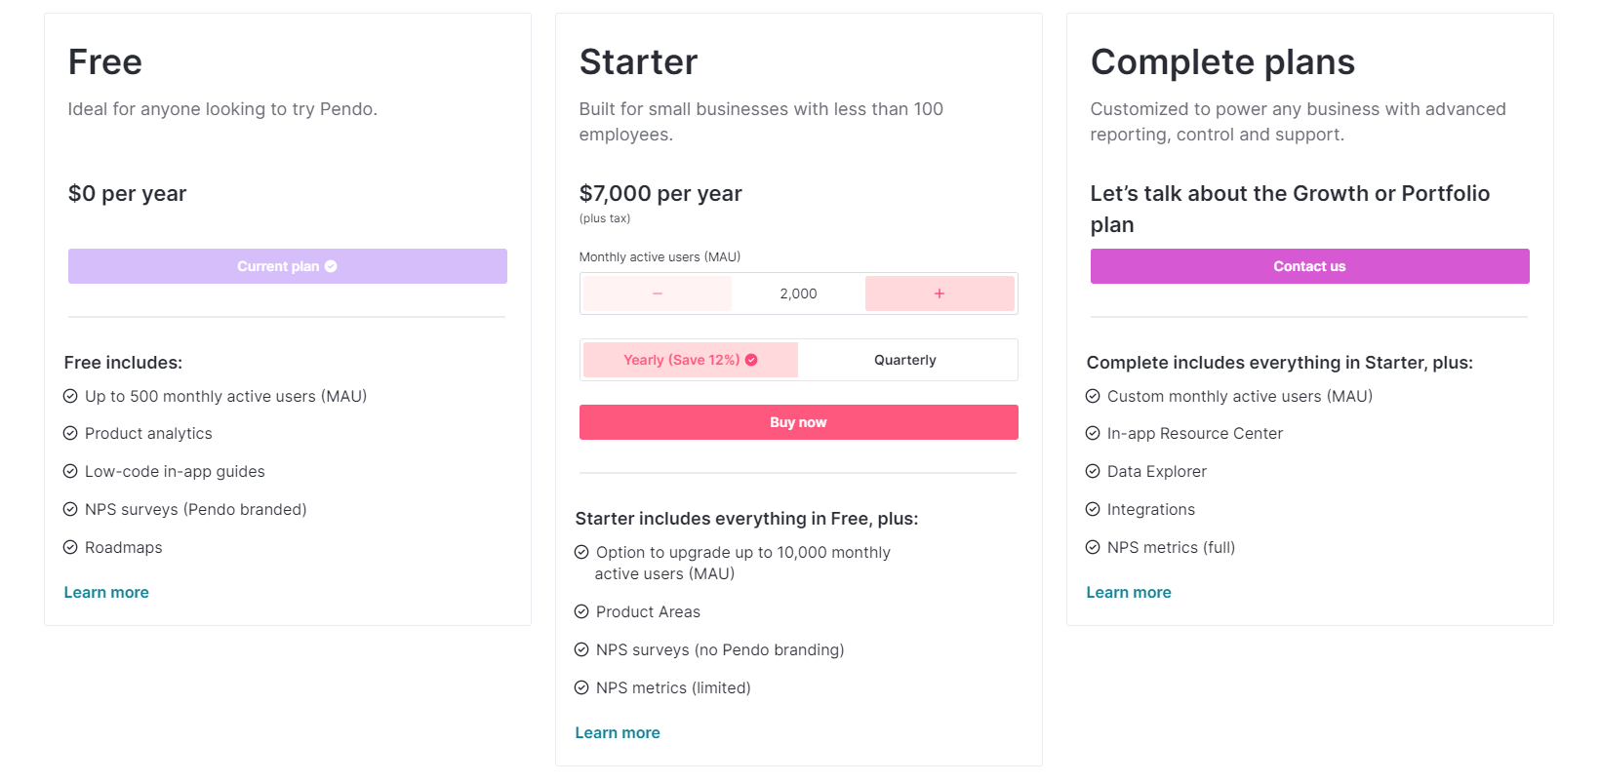
Pricing:

Slide 10
Highlighted Features:
Feature | Free | Starter | Complete Plans
In-app Resource Center | - | - | ✓
Data Explorer | - | - | ✓
Integrations | - | - | ✓
Customer support | - | - | ✓
Product Areas | - | ✓ | ✓
Product Engagement Score (PES) | - | - | ✓
Data retention | 1yr | 2yr | 7yr
API access | - | - | ✓
Webhooks | - | - | ✓
SAML 2.0 SSO | - | - | ✓

Slide 11
Thank you!

